Slide 1
Network Intrusion Detection
CAPSTONE PROJECT
Presented By:
1. Sanmitha V S - College of Engineering Guindy – Information Science and Technology

Slide 2
OUTLINE
Problem Statement (Should not include solution)
Proposed System/Solution
System Development Approach (Technology Used)
Algorithm & Deployment
Result (Output Image)
Conclusion
Future Scope
References

Slide 3
Problem Statement
With the increasing frequency and sophistication of network attacks, there is a pressing need for an effective intrusion detection system (IDS) capable of identifying and responding to various types of threats in real-time. Traditional IDS solutions often struggle to keep pace with evolving attack techniques, leading to missed detections and delayed responses. Therefore, there is a demand for a robust IDS solution that can accurately detect and mitigate threats such as DDoS attacks, port scans, and malware infiltration, while minimizing false positives and ensuring minimal impact on network performance.

Slide 4
Proposed Solution
The proposed system aims to address the challenge of developing an intrusion detection system (IDS) capable of identifying and responding to various types of network attacks in real-time. This involves leveraging machine learning algorithms and real-time network traffic analysis to detect and mitigate threats effectively. The solution will consist of the following components:
Data Collection:
Gather historical network traffic data, including packet headers, payloads, and network flow information.
Incorporate real-time data sources such as threat intelligence feeds, firewall logs, and anomaly detection sensors to enhance detection capabilities.
Data Preprocessing:
Clean and preprocess the collected data to remove noise, handle missing values, and standardize feature formats.
Perform feature extraction to identify relevant network traffic patterns and behavior characteristics indicative of different types of attacks.
Machine Learning Algorithm:
Implement a machine learning-based IDS capable of classifying network traffic into normal or malicious categories.
Utilize supervised learning algorithms like Support Vector Machines (SVM), Random Forest, or Gradient Boosting for classification tasks.
Explore unsupervised learning techniques such as k-means clustering or Isolation Forest for anomaly detection and identifying previously unseen threats.
Deployment:
Develop a scalable and distributed system architecture capable of handling high-volume network traffic in real-time.
Deploy the IDS as a standalone appliance or integrate it into existing network infrastructure, ensuring seamless operation and minimal impact on network performance.
Provide a user-friendly interface or dashboard for monitoring detected threats, configuring detection rules, and responding to security incidents.
Evaluation:
Evaluate the performance of the IDS using metrics such as detection rate, false positive rate, and response time.
Conduct extensive testing and validation using representative datasets and simulated attack scenarios to assess the system's robustness and effectiveness.
Fine-tune the IDS based on feedback from security analysts and continuous monitoring of network activity to adapt to evolving threats.

Slide 5
System Approach
The development and implementation of the intrusion detection system (IDS) will follow a systematic approach to ensure the effectiveness, reliability, and scalability of the solution. The system approach encompasses the following key components:
System Requirements:
Define functional and non-functional requirements based on the objectives and constraints of the IDS project.
Specify performance criteria such as detection accuracy, response time, scalability, and compatibility with existing network infrastructure.
Identify operational requirements including data sources, system integration, user interface design, and deployment environment considerations.
Library Required to Build the Model:
Python: Utilize Python programming language for its extensive libraries and frameworks suitable for machine learning and network analysis tasks.
Scikit-learn: Leverage Scikit-learn library for implementing machine learning algorithms such as Support Vector Machines (SVM), Random Forest, and k-means clustering.
TensorFlow/Keras: Employ TensorFlow or Keras libraries for building deep learning models, particularly Long Short-Term Memory (LSTM) networks for sequence prediction tasks.
Pandas: Use Pandas library for data manipulation and preprocessing tasks, facilitating efficient handling of large-scale network traffic datasets.
Matplotlib/Seaborn: Utilize Matplotlib and Seaborn libraries for data visualization to gain insights into network traffic patterns and model performance.

Slide 6
Algorithm & Deployment
Algorithm Selection:
For the intrusion detection system (IDS), the chosen algorithm will encompass a combination of supervised and unsupervised machine learning techniques tailored to the detection and classification of network attacks. Supervised algorithms such as Support Vector Machines (SVM), Random Forest, and Gradient Boosting will be utilized for classifying network traffic into normal or malicious categories. These algorithms are selected for their ability to handle high-dimensional data and effectively learn complex decision boundaries, making them well-suited for detecting known attack patterns.
Additionally, unsupervised learning techniques including k-means clustering and Isolation Forest will be employed for anomaly detection and identifying previously unseen threats. These algorithms are chosen for their ability to detect deviations from normal network behavior without relying on labeled training data, making them ideal for detecting novel or zero-day attacks.
Data Input:
The input features used by the algorithm will include various attributes extracted from network traffic data, such as packet headers, payload characteristics, flow statistics, and protocol usage patterns. Additionally, real-time data sources such as threat intelligence feeds, firewall logs, and anomaly detection sensors will be incorporated to enhance the detection capabilities of the IDS. These features provide valuable insights into network activity and behavior, enabling the algorithm to distinguish between normal and malicious traffic effectively.
Training Process:
The algorithm will be trained using historical network traffic data containing labeled examples of normal and malicious activity. Supervised learning algorithms such as SVM, Random Forest, and Gradient Boosting will be trained on this labeled dataset to learn the underlying patterns and characteristics of different types of attacks. The training process will involve feature engineering to extract relevant features from the data and model training using techniques like cross-validation and hyperparameter tuning to optimize performance and generalization.
Prediction Process:
During the prediction phase, the trained algorithm will analyze incoming network traffic in real-time to classify it as normal or malicious. The prediction process will involve applying the learned decision boundaries and anomaly detection thresholds to incoming data streams, enabling the algorithm to identify and respond to potential threats promptly. Real-time data inputs from sources such as threat intelligence feeds and anomaly detection sensors will be considered during the prediction phase to adapt to changing threat landscapes and emerging attack patterns.

Slide 7
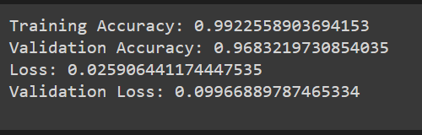
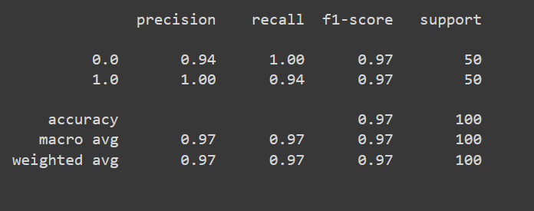
Result
Model’s Performance
Performance Metrics

Slide 8
Conclusion
In conclusion, the development of an advanced intrusion detection system capable of identifying and responding to various network attacks in real-time is crucial for maintaining the security and integrity of modern networks. By leveraging machine learning algorithms and real-time analysis techniques, the proposed IDS aims to provide an effective defense against threats such as DDoS attacks, port scans, and malware infiltration. Through continuous monitoring and proactive response mechanisms, the IDS will help organizations mitigate the impact of cyber threats and safeguard their critical assets.

Slide 9
Future scope
Moving forward, there is potential to enhance the capabilities of the IDS by integrating additional detection techniques, improving the accuracy of machine learning models, and expanding support for emerging threats. Furthermore, future research could focus on developing collaborative IDS frameworks that enable sharing threat intelligence and coordinating response efforts across multiple organizations. Additionally, advancements in hardware acceleration technologies such as GPU computing could further optimize the performance of the IDS and enable scalability to handle larger network traffic volumes.

Slide 10
References
[1] Zhang, Z., Lee, W., & Stolfo, S. J. (2000). "Adaptive intrusion detection: A data mining approach." Annual ACM SIGKDD International Conference on Knowledge Discovery and Data Mining.
[2] Skowyra, R., & Mazurczyk, W. (2019). "Using machine learning algorithms for DDoS attack detection in cloud computing environments." Computers & Security, 84, 230-249.
[3] Roesch, M. (1999). "Snort: Lightweight intrusion detection for networks." Proceedings of the 13th USENIX conference on System administration.

Slide 11
THANK YOU

